Slide 1

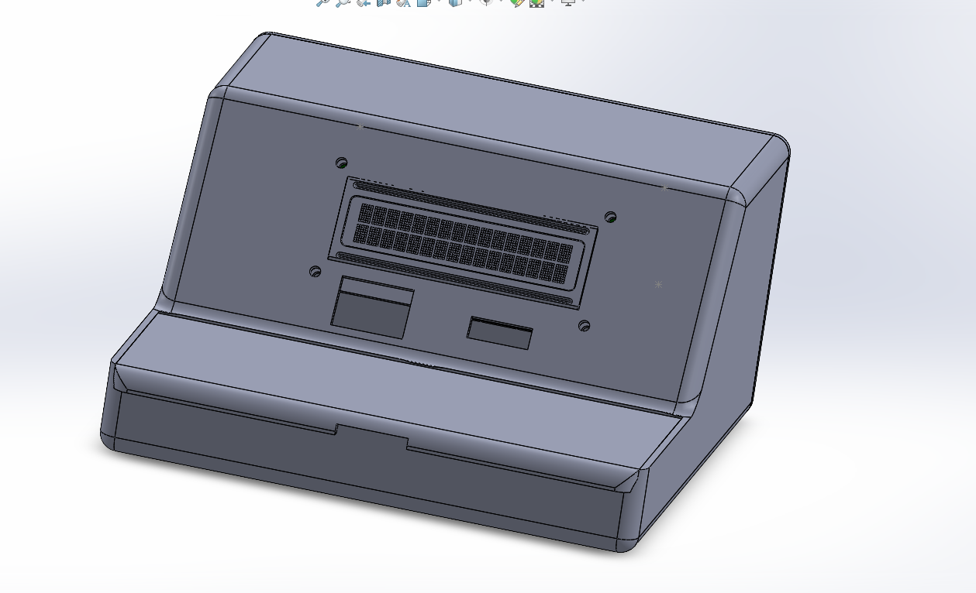

Team VoltCrew
Dual Thermometer

Slide 2
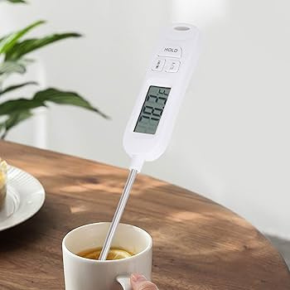

Overview
Introduction
01
What is a thermister
02
Device Architecture
03
Circuit Diagram
04
Methodology
05
Bread Implementation
06
Our Team
08

Slide 3
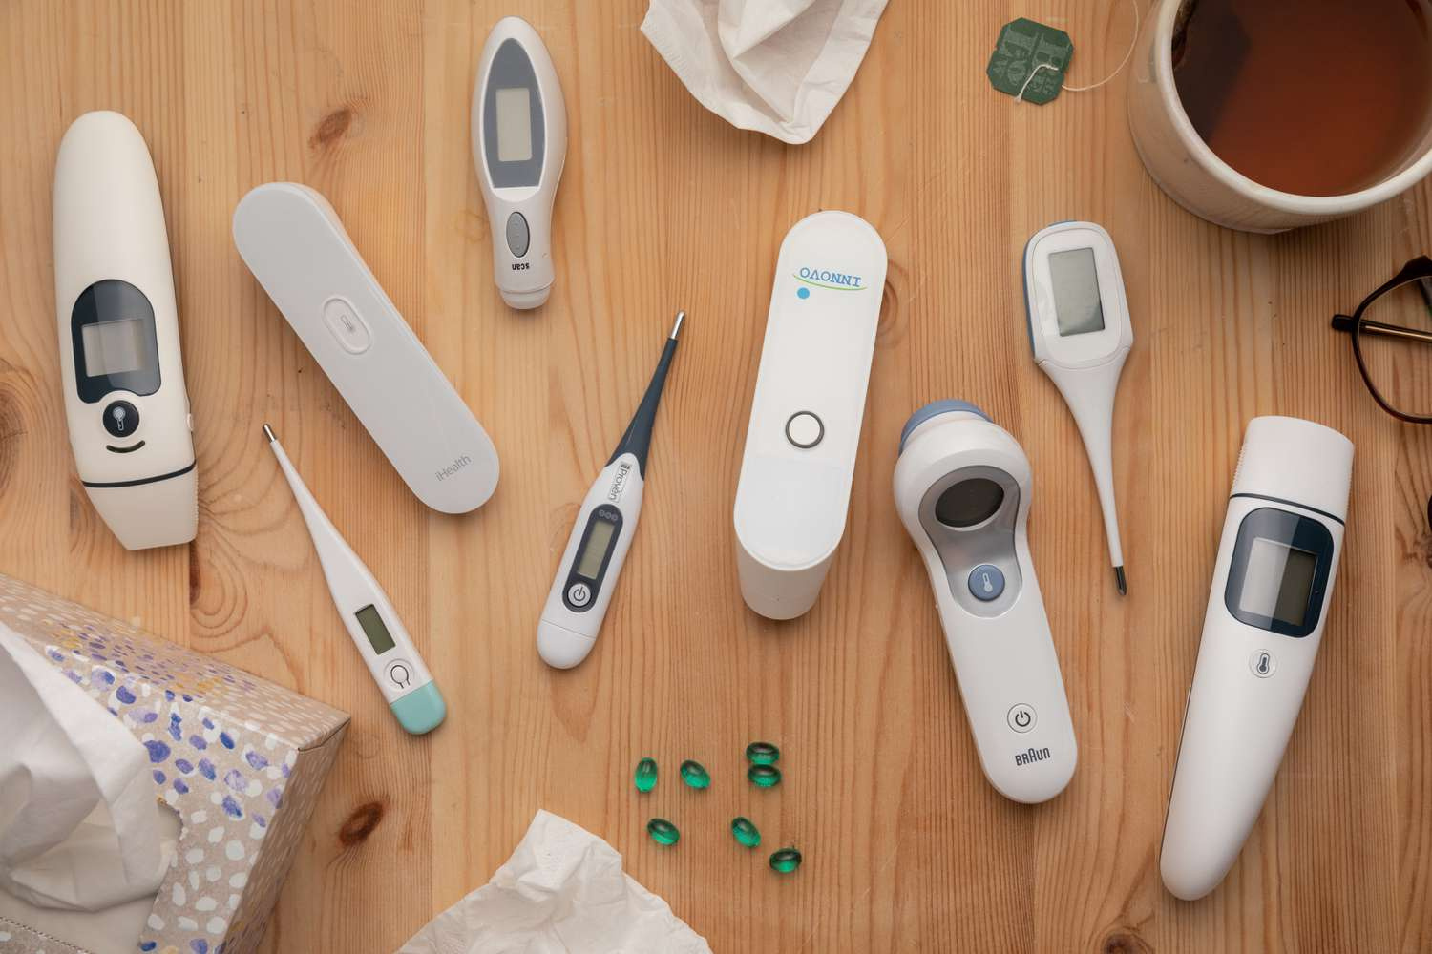
Introduction
Our team is developing a dual thermometer system that measures both body temperature and fluid temperature using two separate probes. The measured temperatures are processed using a microcontroller and displayed on a digital screen. The system relies on analog electronics to ensure accurate and reliable readings from each probe.

Slide 4
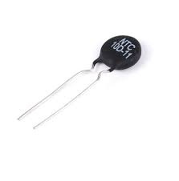
What is a thermister ?
A thermistor is a type of resistor whose resistance changes with temperature.
It is commonly used in temperature sensing applications. There are two main types of thermistors: NTC (Negative Temperature Coefficient), where resistance decreases as temperature increases, and PTC (Positive Temperature Coefficient), where resistance increases with temperature.
In our dual thermometer, NTC 10D-11, PT 100 thermistors are used to measure the temperatures from both the body and fluid probes, providing precise and responsive temperature readings.

Slide 5
Device Architecture
Liquid temeperature input circuit
Instrumentation amplifier
Output Display
Body temeprature input circuit
Power supply

Slide 6
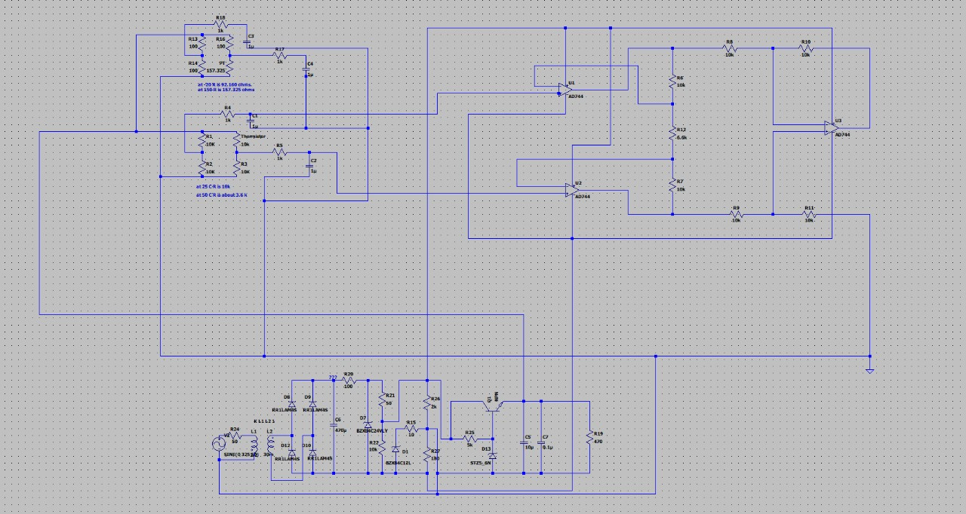
Circuit Diagram

Slide 7
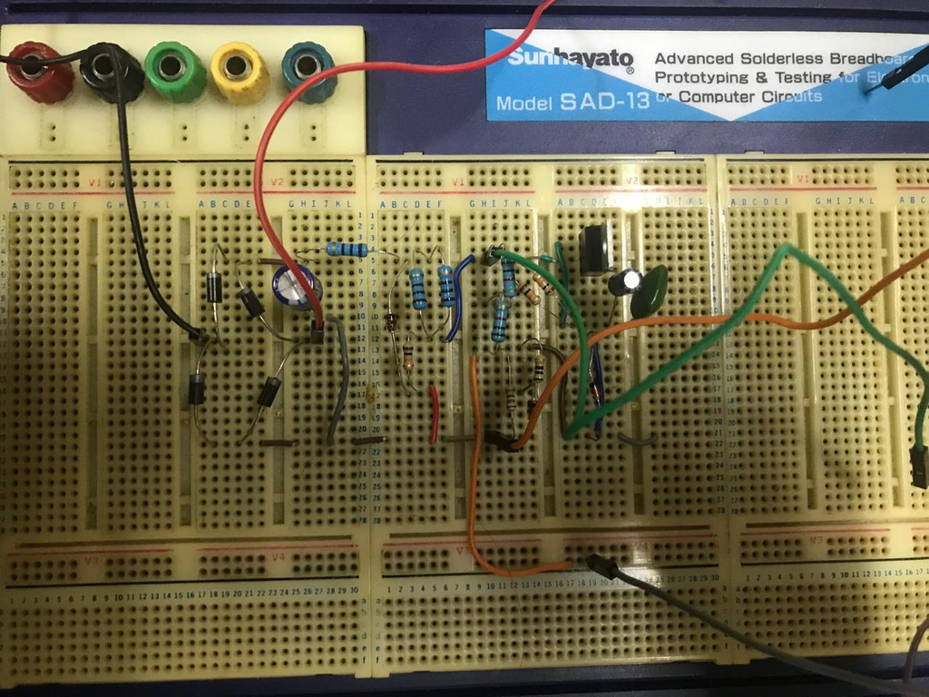
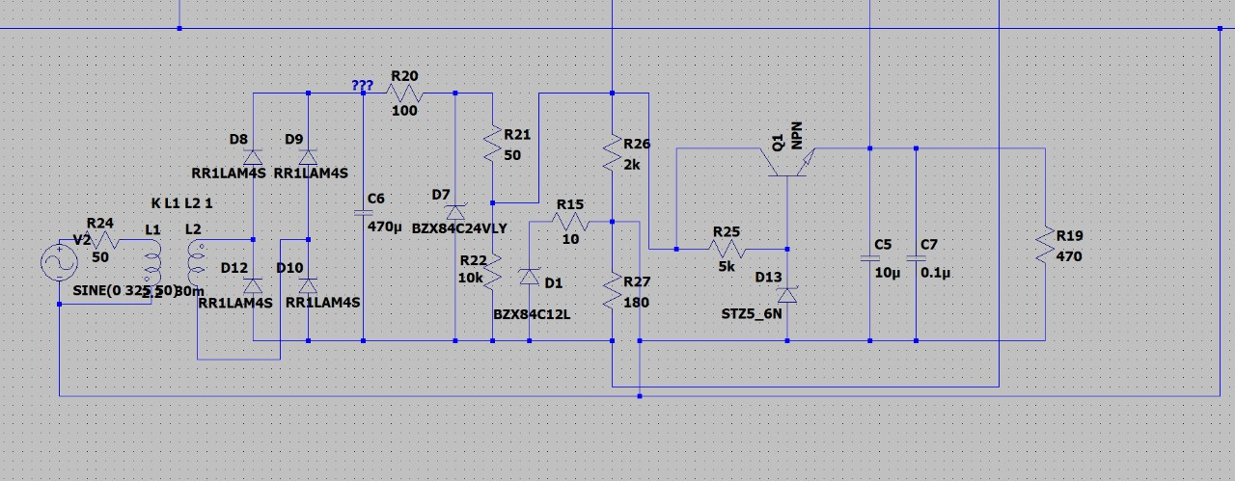
Power Supply Unit
AC to AC Transformer (230V 30V double tap )
Si Diodes-4
Capacitors ( 470,0.1,10 microF)
Zener Diodes (24,10,5.6)
npn Transistor-1
Resistors (10,50, 10, 100, 180, 470,2k, 5k, 10k)

Slide 8
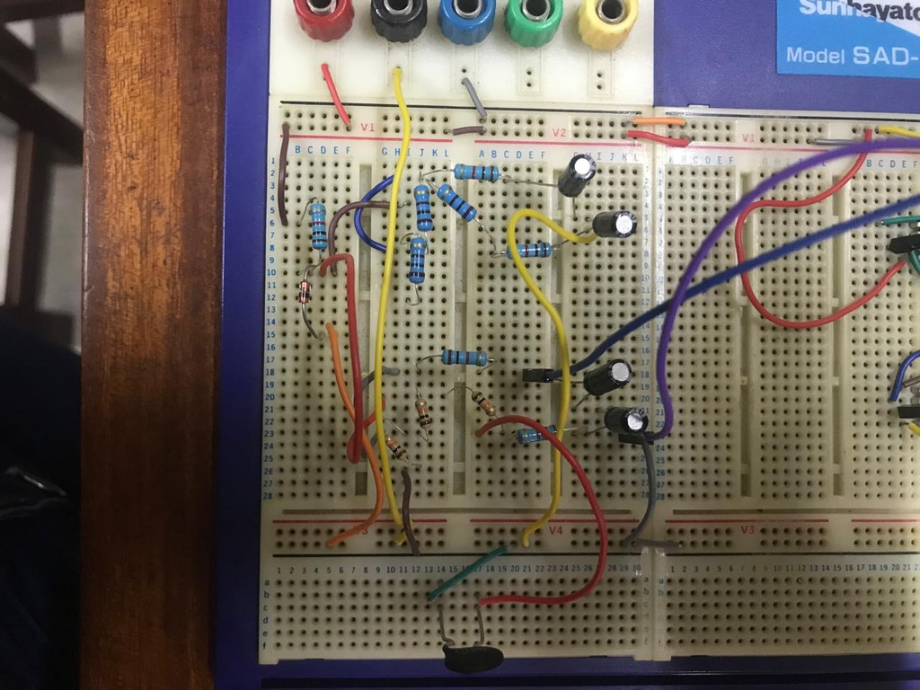
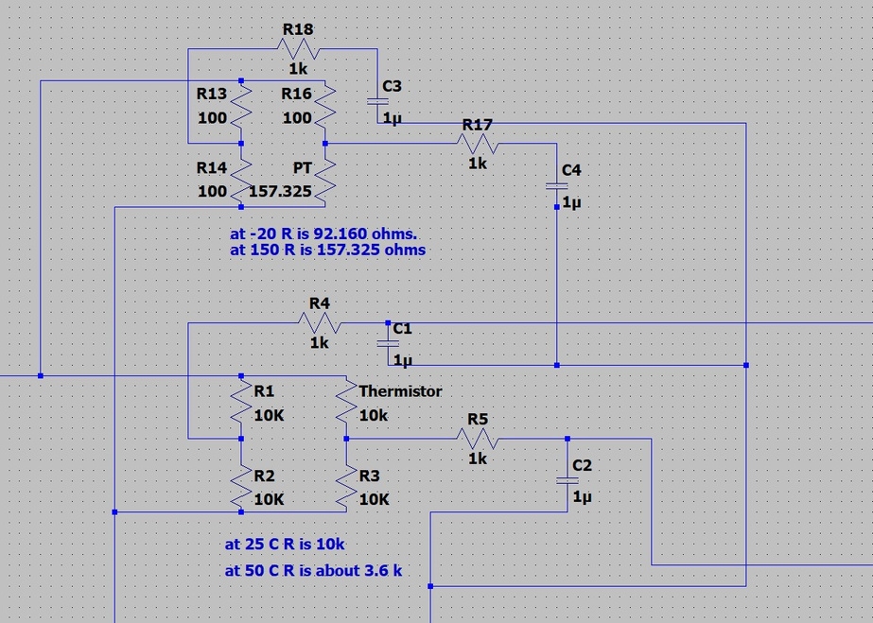
Linearization and Filter Circuit
Body Temperature
Input- PT100 thermister
Linearization- 3 10k resistors
LPF-1k resister-2, 10 microF capacitors-2
Fluid Temperature
Input- NTC 10k thermister
Linearization- 3 100 ohm resistors
LPF-1k resister-2, 10 microF capacitors-2

Slide 9
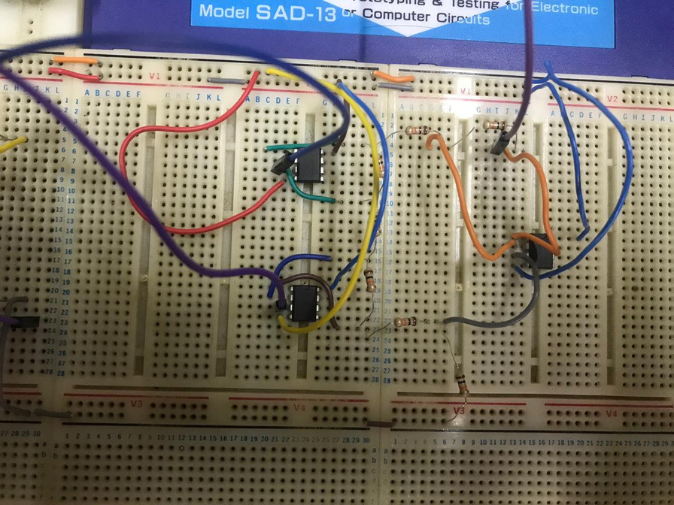
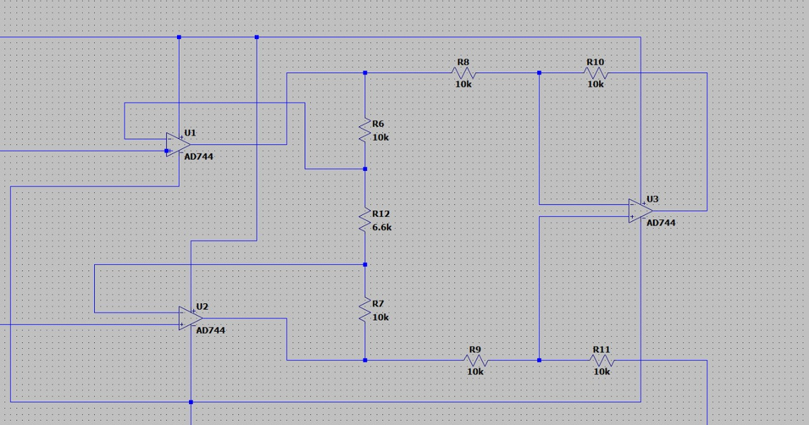
Instrumentation Amplifier
NE 5532 OPAMPs-3
Resisters ( 10k-6, 6.6k-1 )

Slide 10
Reasoning for Component Selection
Component | Reason
Transformer ( 230V to 30V double tap ) | According to the power requirement of the OPAMPs and other circuit components and proper functionality of the whole circuit
TL702 CP OPAMPs | Wide Supply Voltage Range Low Offset Voltage-ensures precise signal amplification High Slew Rate and Stability
TIP41C | Capability to switch currents up to 500 mA Maximum voltage rating (Vceo = 60V) allows it to handle a wide range of supply voltages without breakdown.
Instrumentation amplifier | High Accuracy and Noise Rejection Simplified Design-easy gain adjustment High Input Impedance-Prevents loading effects

Slide 11
Reasoning for Component Selection
Component | Reason
NTC 10K thermistor for fluid | Wide Measurement Range
PT100 thermistor for body | Provides accurate and stable readings within the typical human body temperature range

Slide 12
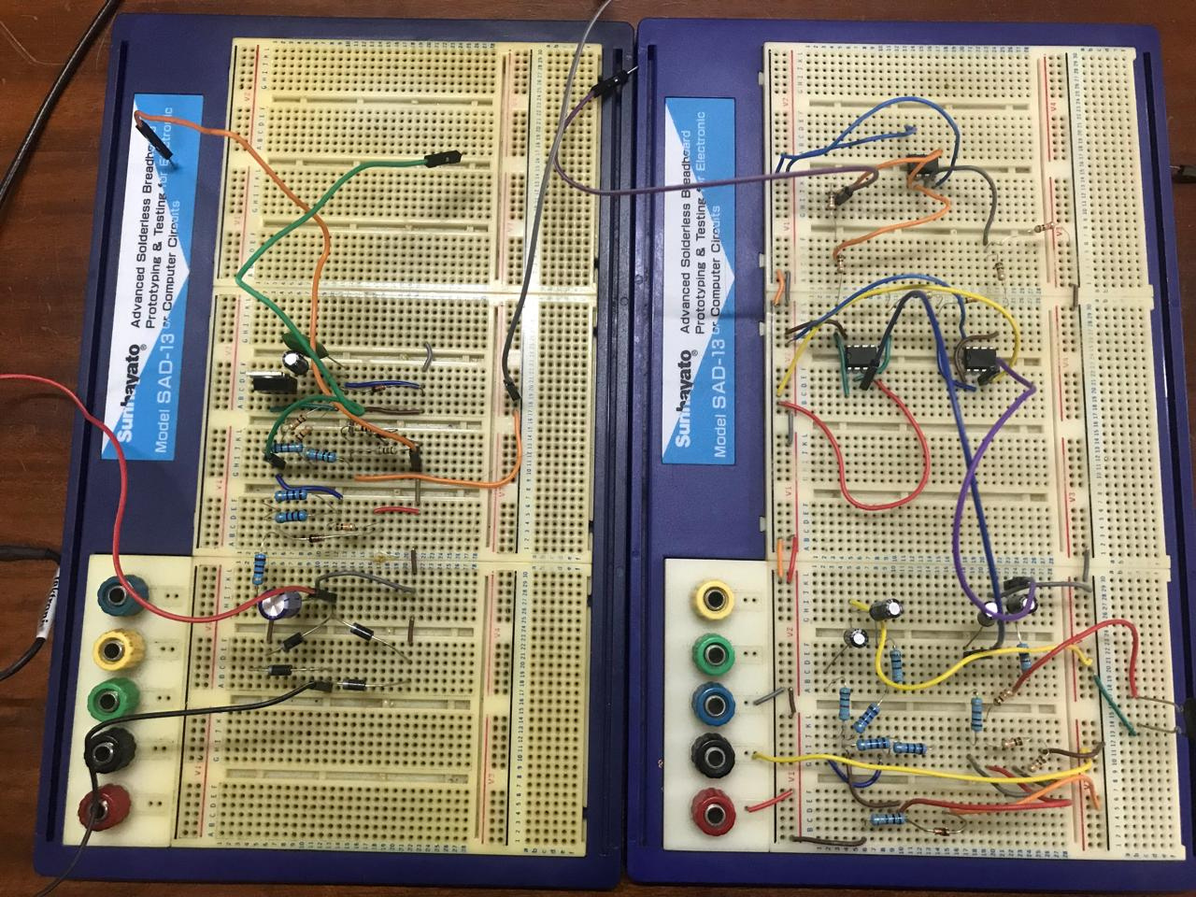
Breadboard Implentation

Slide 13
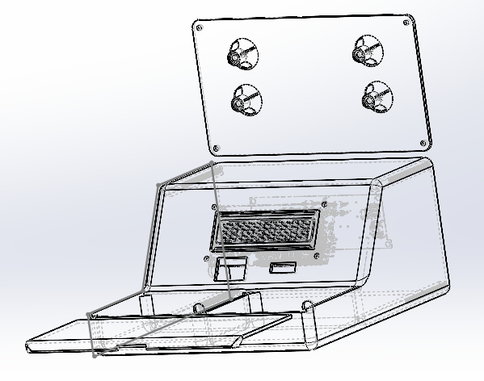
Enclosure

Slide 14
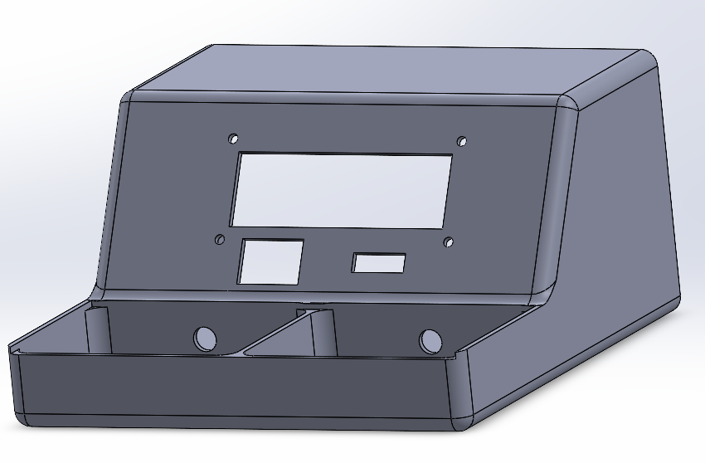
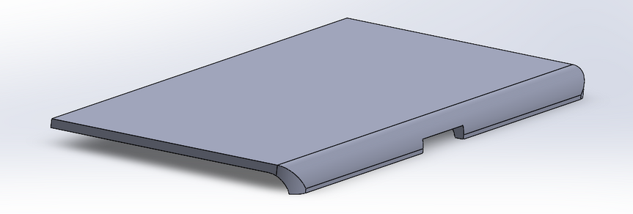
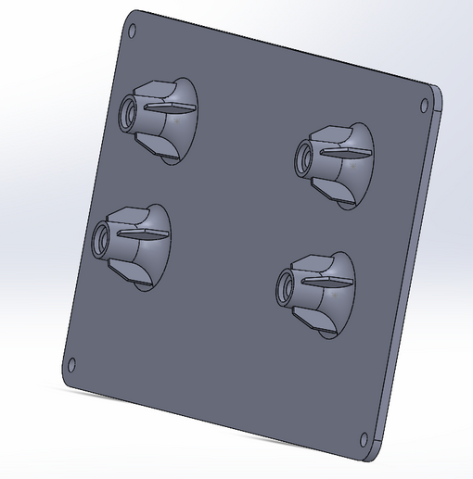

Enclosure

Slide 15
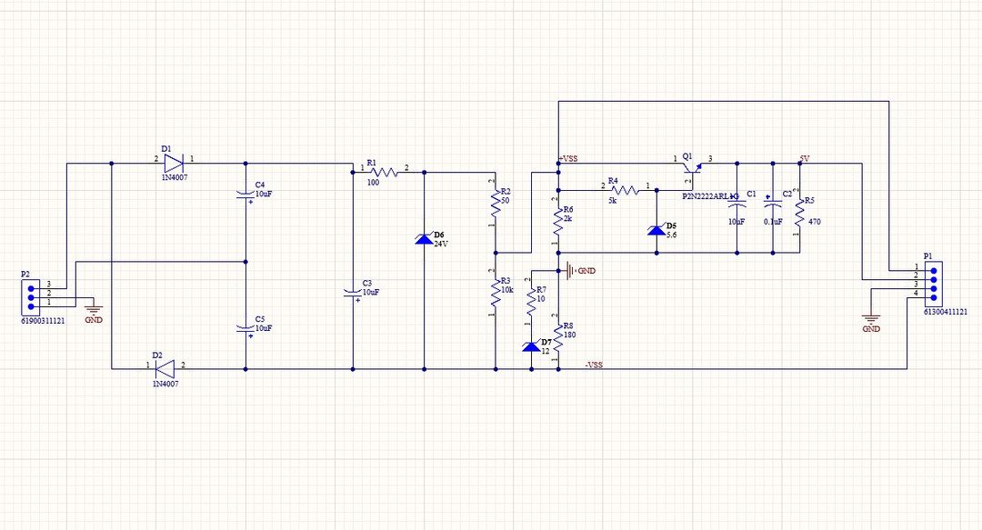
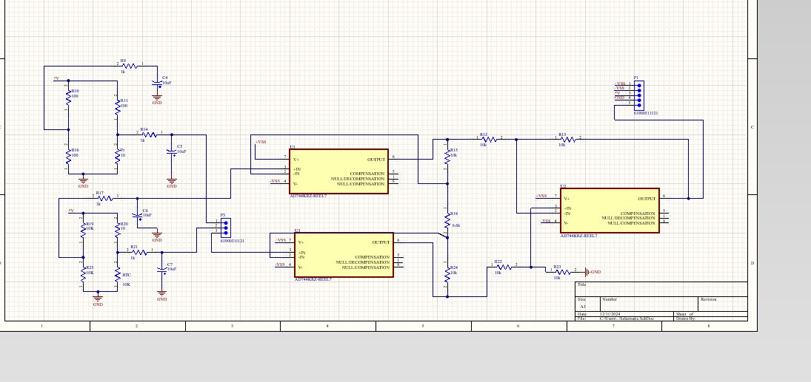
Altium Design
Power Supply Unit
Amplifier Circuit

Slide 16
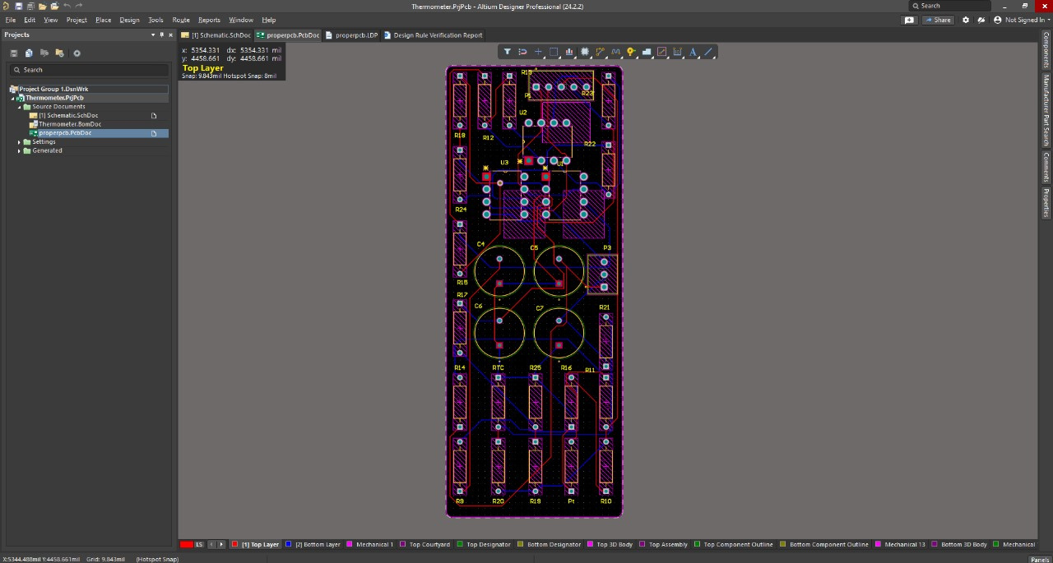
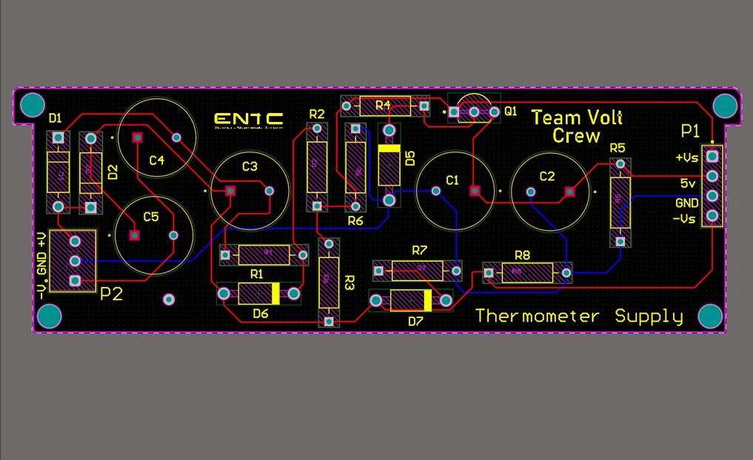
Altium Design
Power Supply Unit
Amplifier Circuit

Slide 17
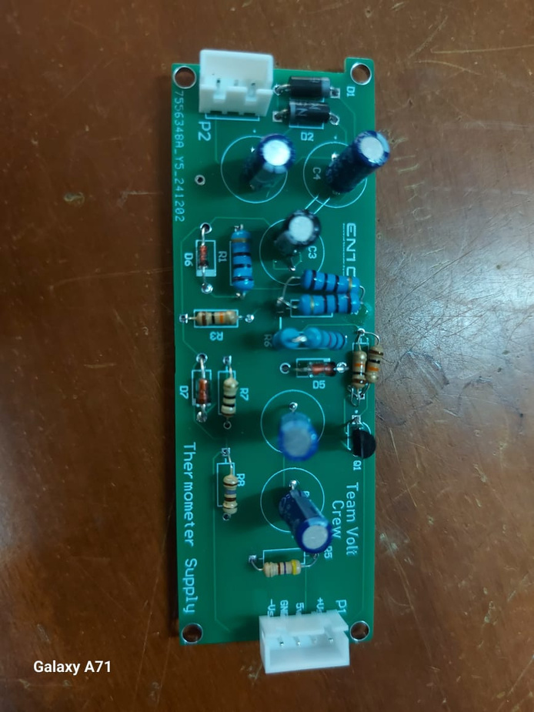
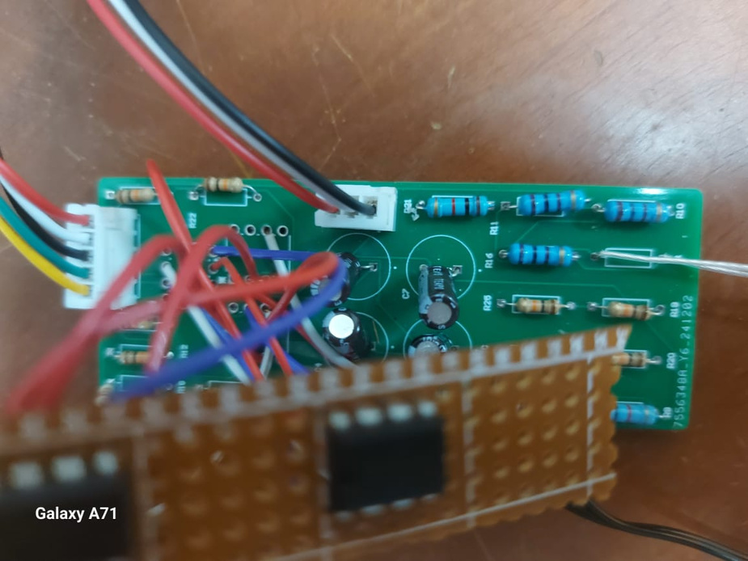
PCB
Power Supply Unit
Amplifier Circuit

Slide 18




Our Team
Luchitha Perera
Sanugi Wickramasinghe
Benul Wijerathna
Hansani Kaumadi

Slide 19

Team
Volt Crew
THANK YOU!

